Slide 1


ESSAY Question #5 ~ Top Web Hosting Sites
CIS 234E
Electronic Commerce
Website
Your Student ID
your email address
Email to “DrV”
ProfessorVillegas@gmail.com
Place your pix above
And name below
Page 1
CIS 234E ~ ELECTRONIC COMMERCE WEBSITE * YOUR FULL NAME + Phone Number

Slide 2
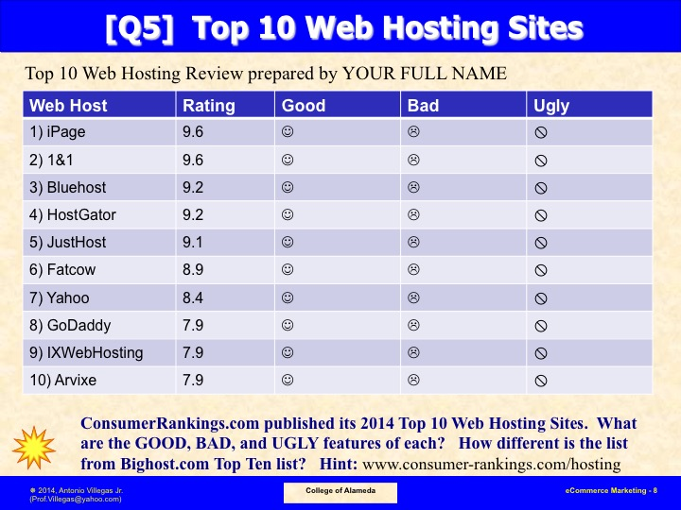
Page 2
CIS 234E ~ ELECTRONIC COMMERCE WEBSITE * YOUR FULL NAME + Phone Number

Slide 3
ESSAY Question 5 ~ Look at http://www.webhostingbest10.com
Top #1
Top #6
Top #2
Top #7
Top #3
Top #8
Top #4
Top #9
Top #5
Top #10
Identify the TOP TEN Web Hosting Sites with their LOGOS above
Page 3
CIS 234E ~ ELECTRONIC COMMERCE WEBSITE * YOUR FULL NAME + Phone Number

Slide 4
ESSAY Question 5 ~ 2017 webhostingbest10.com (Top 1)
Top #1
Explain the features why the above Web Hosting Site is RANKED as such!
Page 4
CIS 234E ~ ELECTRONIC COMMERCE WEBSITE * YOUR FULL NAME + Phone Number

Slide 5
ESSAY Question 5 ~ 2017 webhostingbest10.com (Top 2)
Top #2
Explain the features why the above Web Hosting Site is RANKED as such!
Page 5
CIS 234E ~ ELECTRONIC COMMERCE WEBSITE * YOUR FULL NAME + Phone Number

Slide 6
ESSAY Question 5 ~ 2017 webhostingbest10.com (Top 3)
Top #3
Explain the features why the above Web Hosting Site is RANKED as such!
Page 6
CIS 234E ~ ELECTRONIC COMMERCE WEBSITE * YOUR FULL NAME + Phone Number

Slide 7
ESSAY Question 5 ~ 2017 webhostingbest10.com osting (Top 4)
Top #4
Explain the features why the above Web Hosting Site is RANKED as such!
Page 7
CIS 234E ~ ELECTRONIC COMMERCE WEBSITE * YOUR FULL NAME + Phone Number

Slide 8
ESSAY Question 5 ~ 2017 webhostingbest10.com (Top 5)
Top #5
Explain the features why the above Web Hosting Site is RANKED as such!
Page 8
CIS 234E ~ ELECTRONIC COMMERCE WEBSITE * YOUR FULL NAME + Phone Number

Slide 9
ESSAY Question 5 ~ 2017 webhostingbest10.com (Top 6)
Top #6
Explain the features why the above Web Hosting Site is RANKED as such!
Page 9
CIS 234E ~ ELECTRONIC COMMERCE WEBSITE * YOUR FULL NAME + Phone Number

Slide 10
ESSAY Question 5 ~ 2017 webhostingbest10.com (Top 7)
Top #7
Explain the features why the above Web Hosting Site is RANKED as such!
Page 10
CIS 234E ~ ELECTRONIC COMMERCE WEBSITE * YOUR FULL NAME + Phone Number

Slide 11
ESSAY Question 5 ~ 2017 webhostingbest10.com (Top 8)
Top #8
Explain the features why the above Web Hosting Site is RANKED as such!
Page 11
CIS 234E ~ ELECTRONIC COMMERCE WEBSITE * YOUR FULL NAME + Phone Number

Slide 12
ESSAY Question 5 ~ 2017 webhostingbest10.com (Top 9)
Top #9
Explain the features why the above Web Hosting Site is RANKED as such!
Page 12
CIS 234E ~ ELECTRONIC COMMERCE WEBSITE * YOUR FULL NAME + Phone Number

Slide 13
ESSAY Question 5 ~ 2017 webhostingbest10.com (Top 10)
Top #10
Explain the features why the above Web Hosting Site is RANKED as such!
Page 13
CIS 234E ~ ELECTRONIC COMMERCE WEBSITE * YOUR FULL NAME + Phone Number

Slide 14
ESSAY Question 5 ~ Compare with top10bestwebsitehosting.com
Top #1
Top #6
Top #2
Top #7
Top #3
Top #8
Top #4
Top #9
Top #5
Top #10
Identify the TOP TEN Web Hosting Sites with their LOGOS above
Page 14
CIS 234E ~ ELECTRONIC COMMERCE WEBSITE * YOUR FULL NAME + Phone Number

Slide 15
ESSAY Question 5 ~ Compare with consumer-rankings.com/hosting/
Top #1
Top #6
Top #2
Top #7
Top #3
Top #8
Top #4
Top #9
Top #5
Top #10
Identify the TOP TEN Web Hosting Sites with their LOGOS above
Page 15
CIS 234E ~ ELECTRONIC COMMERCE WEBSITE * YOUR FULL NAME + Phone Number

Slide 16
ESSAY Question 5 ~ Bibliographical References
Use MLA Citation for your Bibliography entries
~ go to this website for help
➔ https://www.refme.com/us/citation-generator/mla/
Page 16
CIS 234E ~ ELECTRONIC COMMERCE WEBSITE * YOUR FULL NAME + Phone Number

